Slide 1
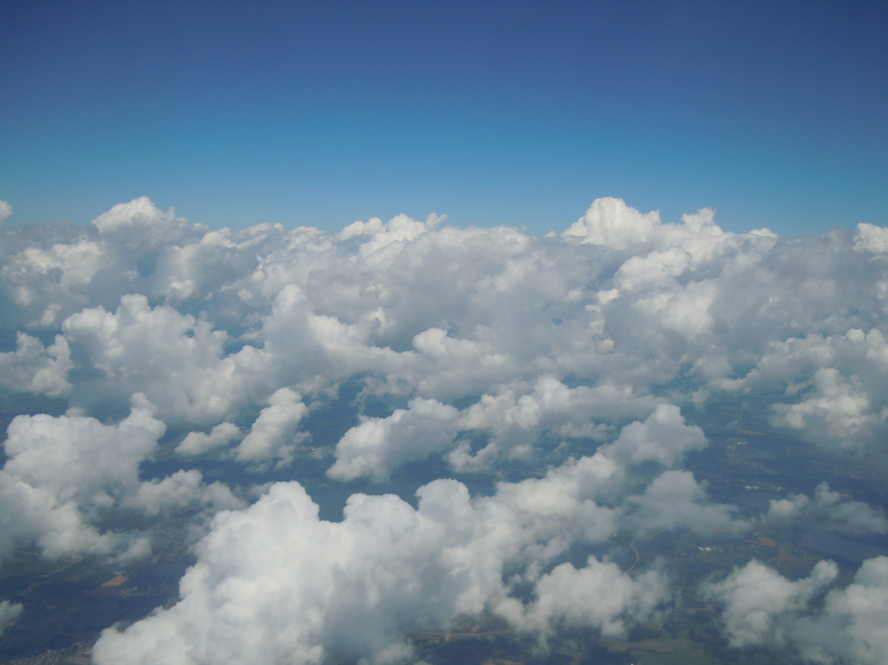
Advanced Air Academy
2010
Through the eyes of Noemi Zuniga and Nicholas Bettencourt

Slide 2
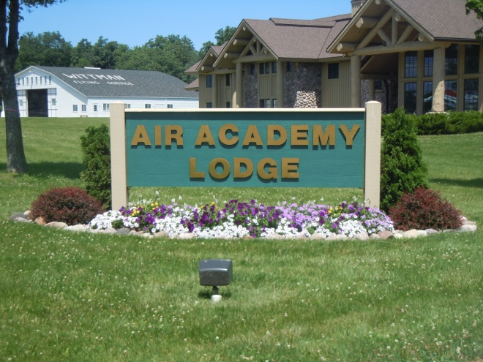
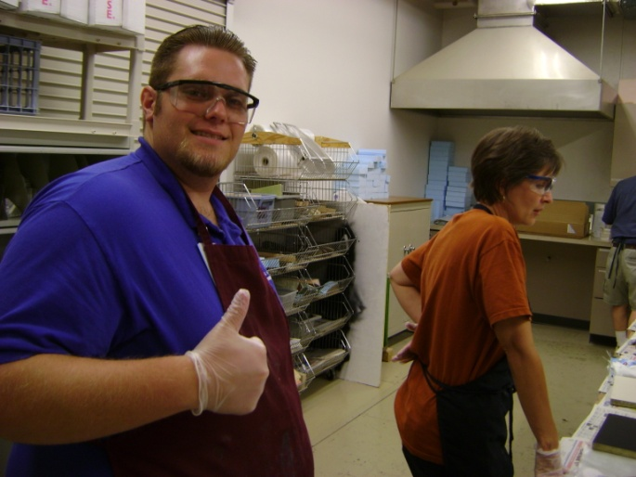
First Impression
Really big
Staff was very welcoming
Rooms where great
Everything felt safe
It was like being part of and extended family
Best of all the food was awesome

Slide 3
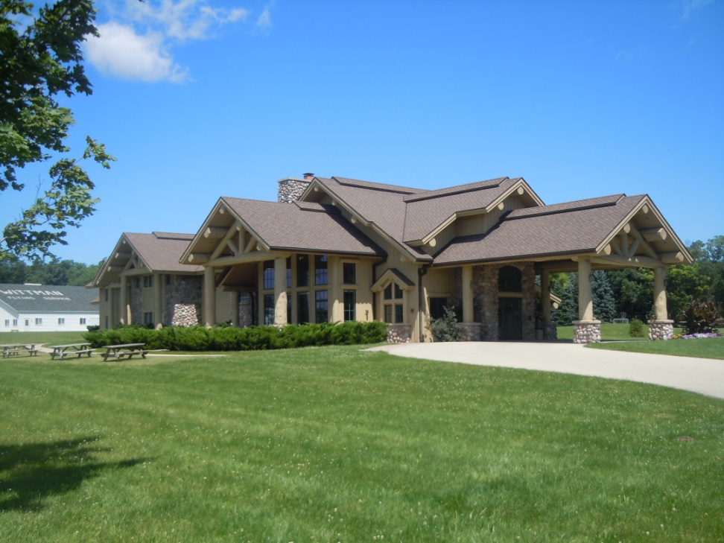
Overview
At the Lodge
Class Room
Workshops
Team Building
Flying
Air venture and the museum

Slide 4
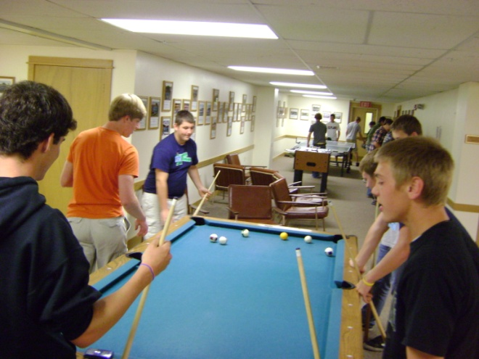
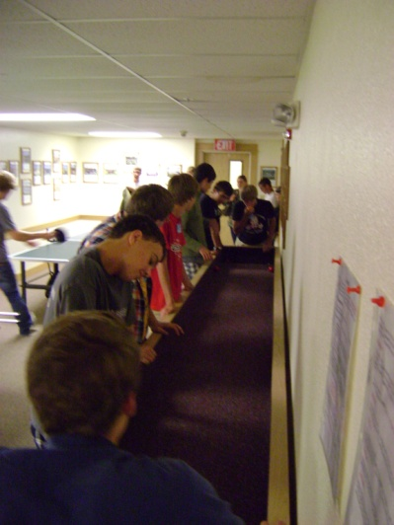
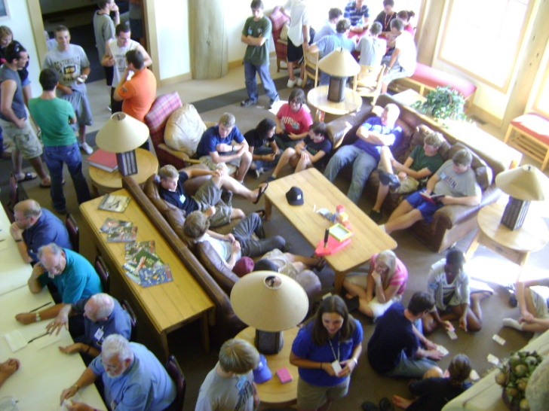
At the Lodge
We could do so many things like:
  Carpet ball, Pool, Foosball, Ping-Pong
  Flight simulators
  Card games
  Hanging out
  Fishing, Frisbee and more!!!
The rooms where amazing:
  Everyone had their own space
  Everything felt safe
Food was GREAT
  Home made
  Dessert everyday!!
  Great bonding opportunity
Staff, Directors and campers all got along great
  We were all on the same level
  Every one showed respect an manners
  Staff was fun

Slide 5
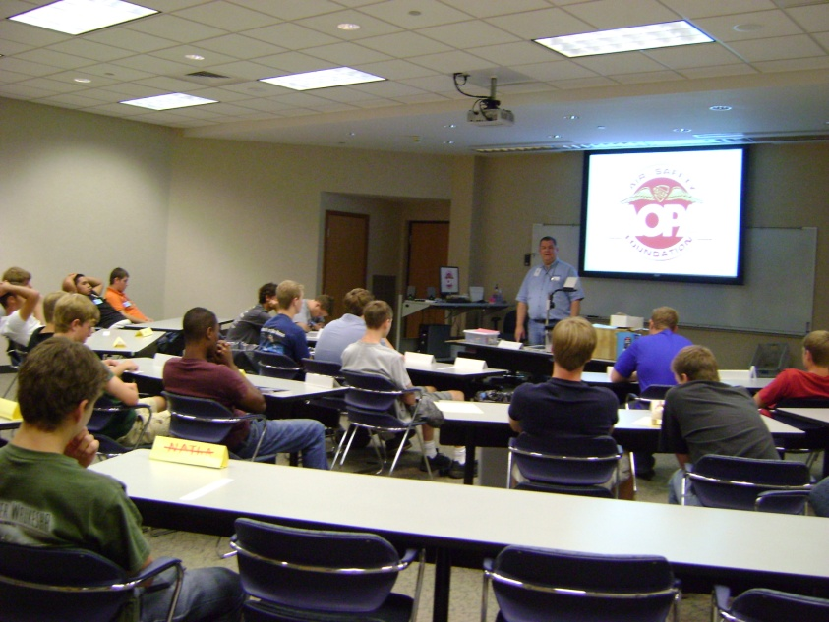
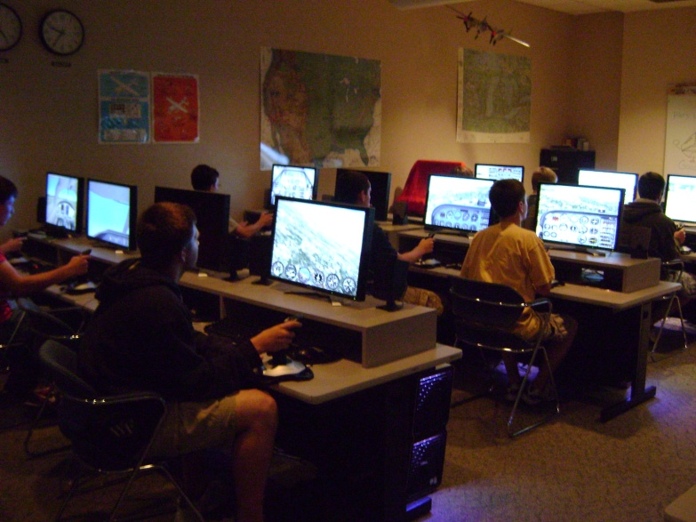
Class Room
Brian Lee- engineer, our teacher
Weather
  Relation with aviation, how and where to get it, how to read it, safe not safe
Structures
  Connection to workshops, shape and size change airplane
Cool Pics and stories
  Previous jobs
  Cool airplanes

Slide 6
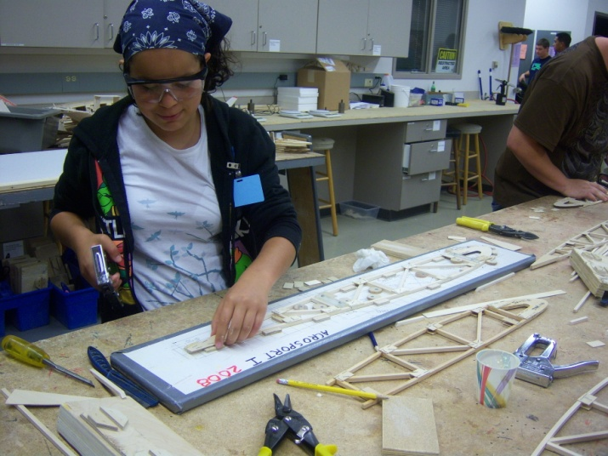
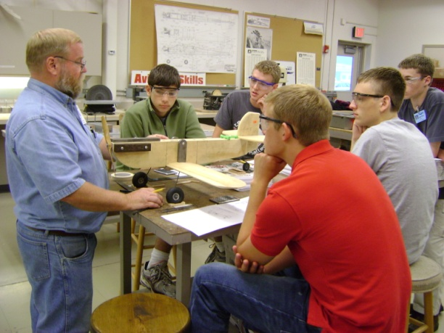
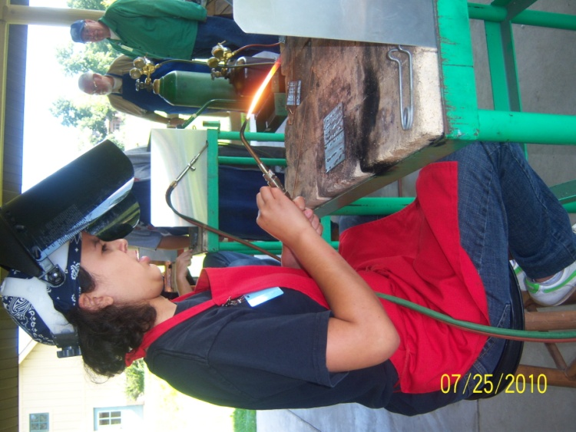
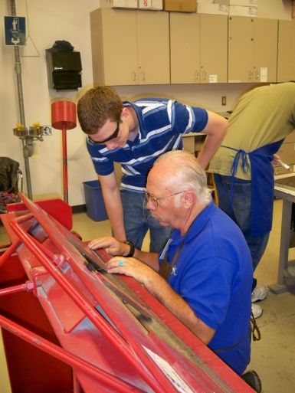
Workshops
Compost
  Clipboards
  Airplane parts: lighter, strong, easy to get
Wood Working
  Wing rib
  Many designs, long history, developed, changes air flow
Sheet Metal
  Spark plug tray
    Drill press, cleco clamps, center punch
Aviation Technology
  Center of gravity, safe and legal flying situations and weights
Welding
  Simple techniques, on and off

Slide 7
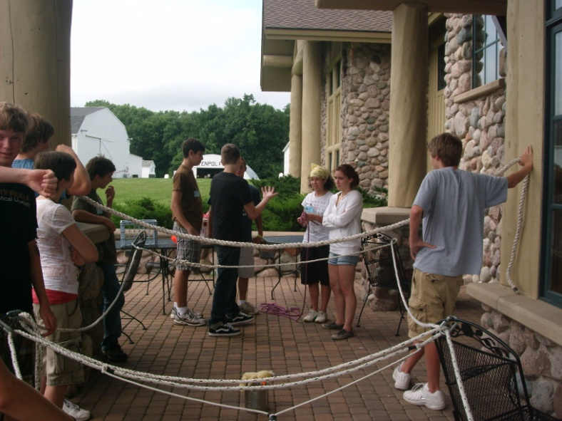
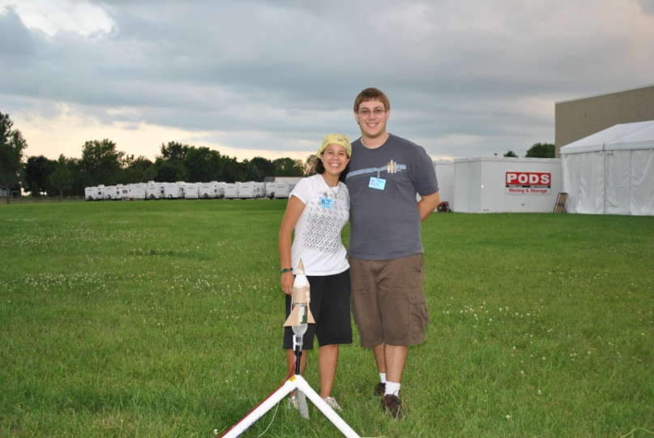
Team Building
Ice breakers
  Name games, introductions, room activities, conversations at meals
Sports
  Organized and random
  Soccer, volleyball, Frisbee, capture the flag
Lower ropes courses
  Trust exercises, strategy, spider web activity, save ducky
Pressurized rockets
  build rocket that will fly and land safely and protect egg
  Limited supplies
Gliders
  Design and build a glider
  Must fly or stay in air

Slide 8
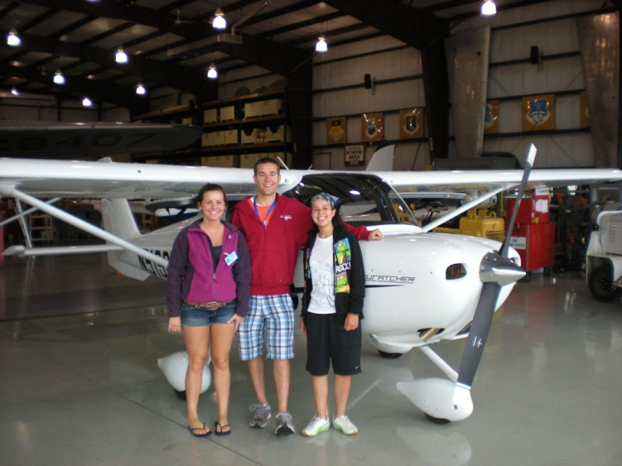
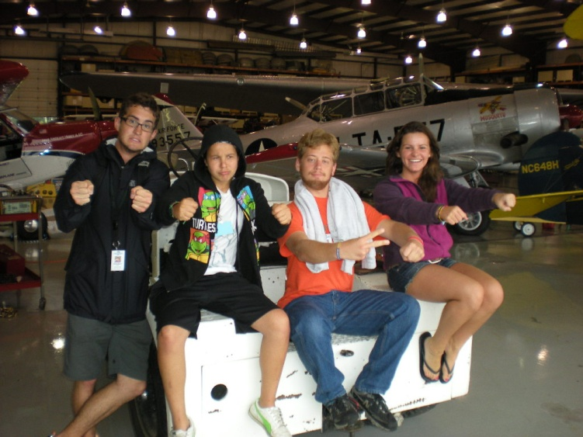
Flying
Pre Flight
  Whole process run trough with assistance of pilot
Flight
  All you
  Complete maneuvers instructed by staff
Questions answered
  Translations used when necessary
Hanging with the pilots
  We had a… situation and… we hung out till it was over
  We saw planes up close
Dream come true

Slide 9
Airventure and the Museum
We can talk about this one…. Because really, you have to be there so experience it
We have some videos and some pictures to give you a glimpse
http://www.youtube.com/watch?v=oEDGMxYaO5Y

Slide 10
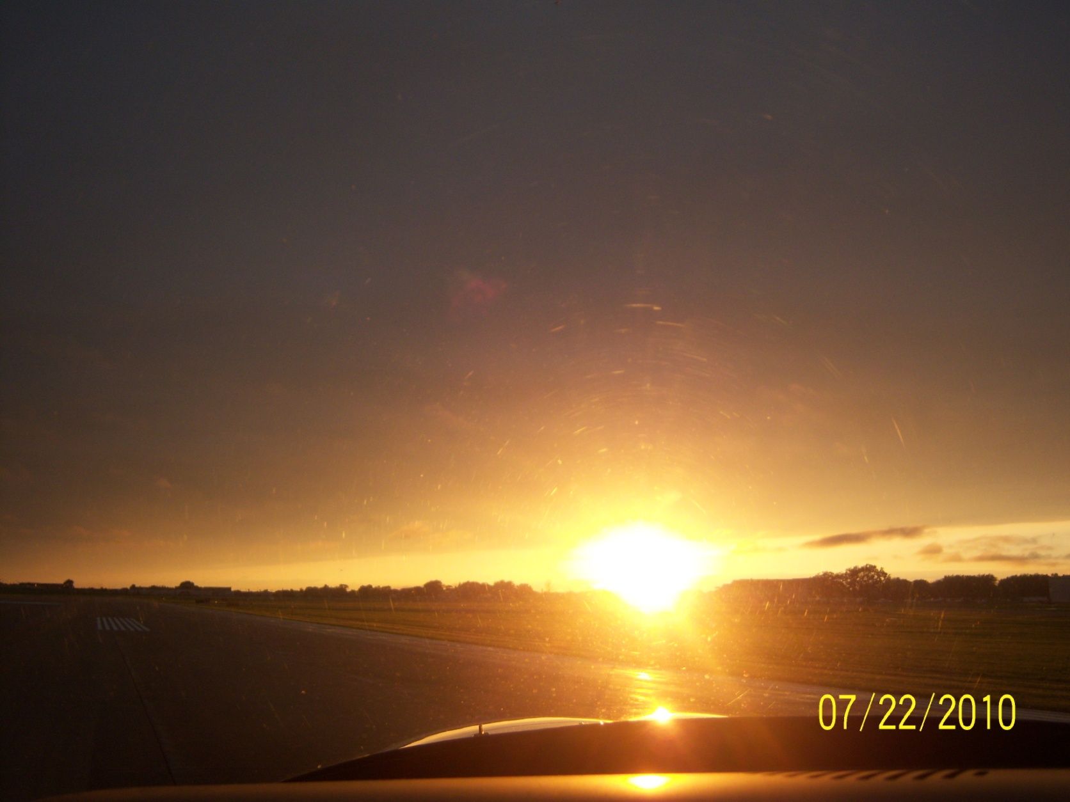
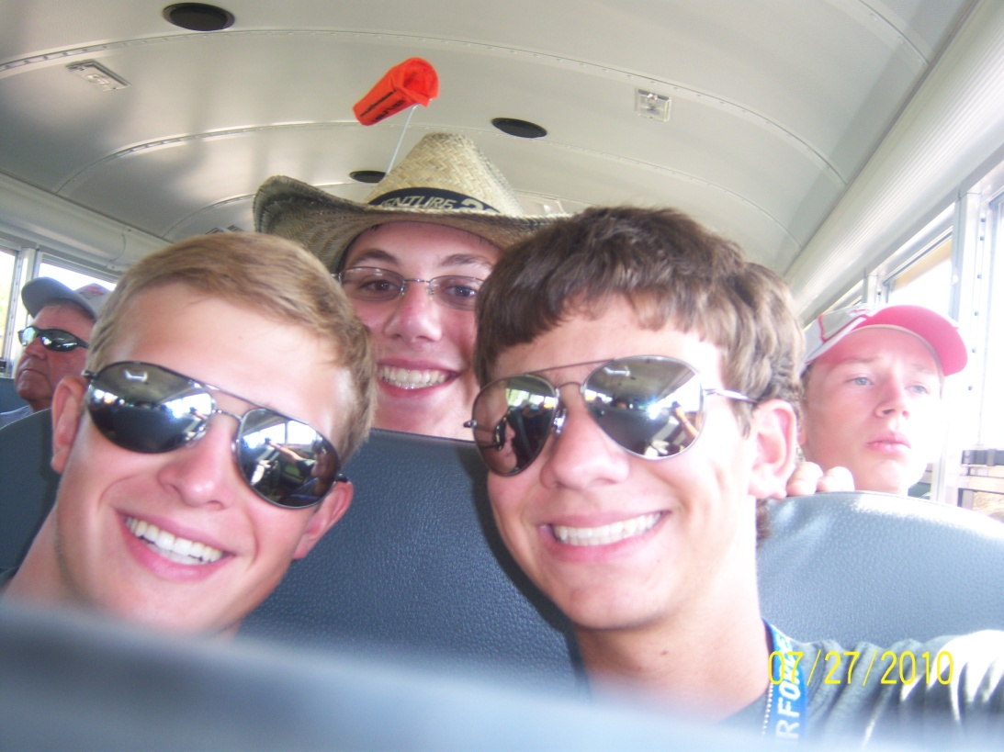
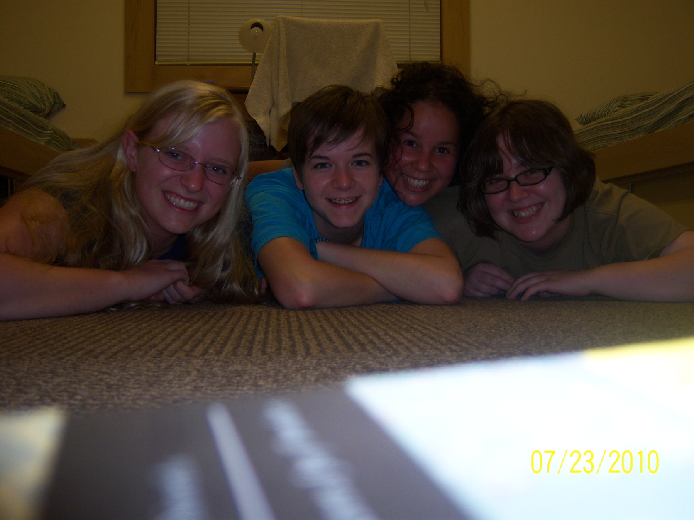
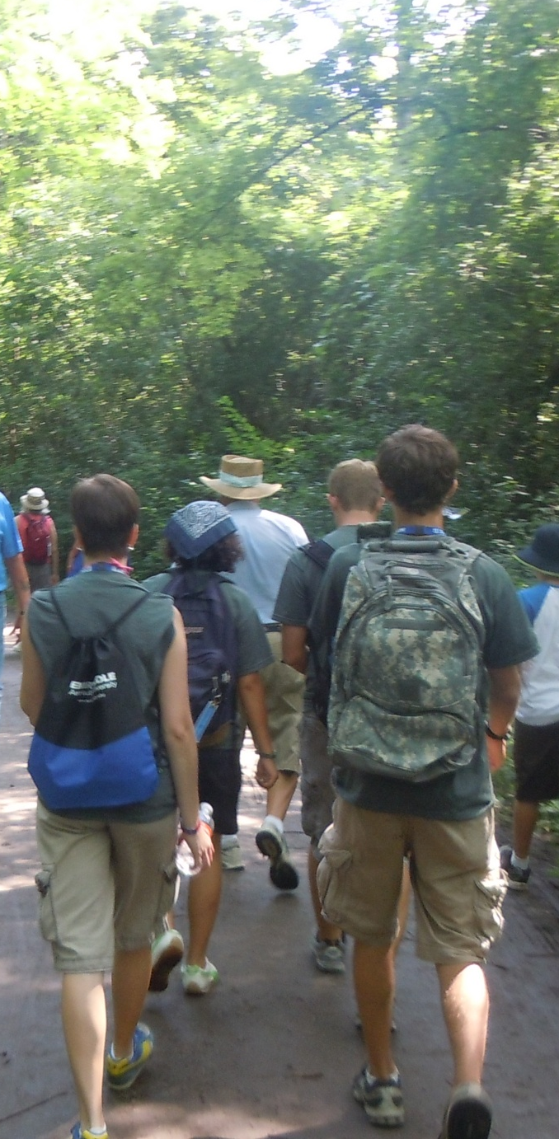
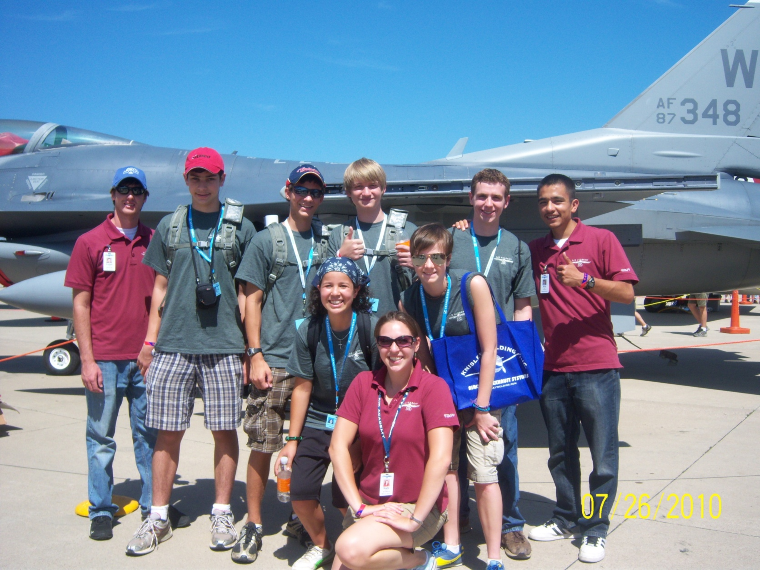
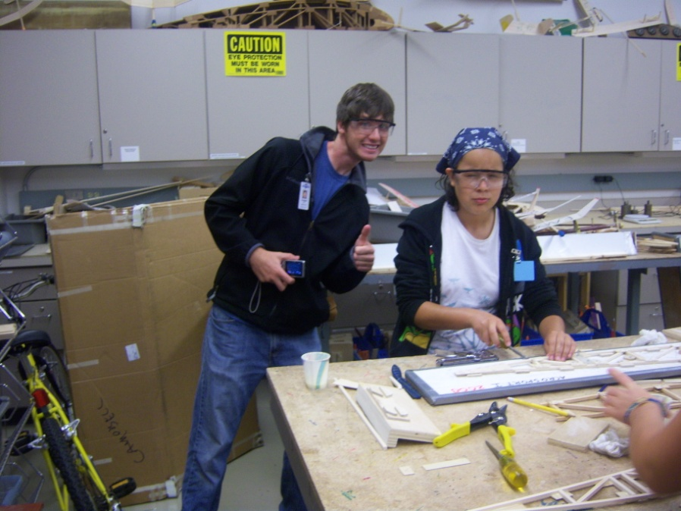
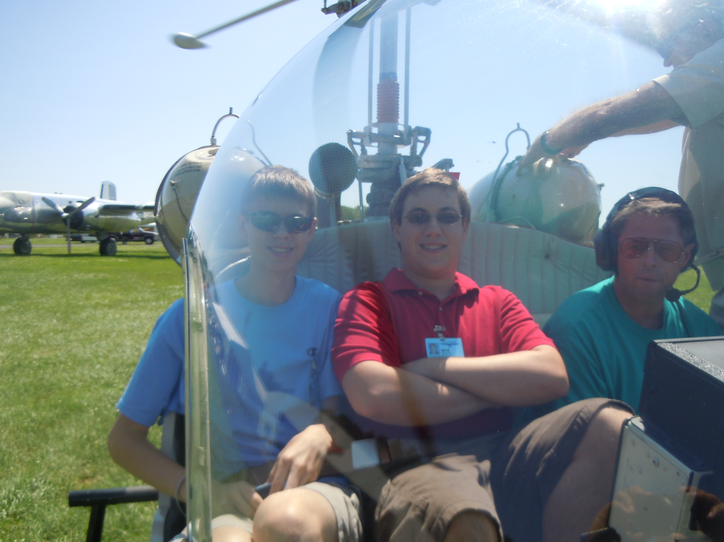
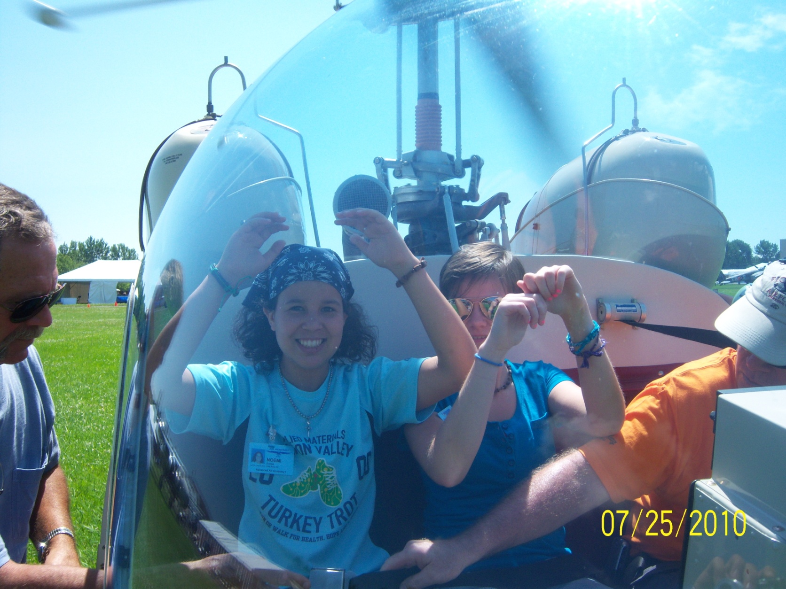
The lasting effect
The people we met
The friends we made
The heroes we discovered
Memories that we created
Everything we learned
Getting closer to our dreams

